Slide 1

Analysis of Microbrewery Data Emphasizing ABV IBU Style and State
By: Jeff Nguyen and Adam Ruthford
October 20, 2019

Slide 2
Executive Summary (Keep/ or Not?)
Understand how data was cleaned
Show summary statistics on:
ABV
IBU
Breweries by State
Identify Trends between ABV and IBU
Additional Analysis

Slide 3
Notes about data analysis, cleansing data, and limitations of data
The data provided contains no volumetric measure of sales
Data can not be used to answer how much was sold only what is available to be sold
Beer style data is unnormalized (over 100 styles)
5 beers lack style data
Brewery and Beer data is duplicated
Missing data points exist for IBU rating and ABV percent
ABV percent data is missing for 62 beers
IBU rating data is missing for 990 beers

Slide 4
Remove duplicate breweries and beers
Calculate average IBU and ABV by style
Use style averages to replace missing data
Ignore five beers missing style
After cleaning only 51 beers missing IBU
After cleaning no beers missing ABV
Data Cleaning

Slide 5
State | Brewery Count | State | Brewery Count | State | Brewery Count
AK | 7 | KY | 4 | NY | 16
AL | 3 | LA | 5 | OH | 15
AR | 2 | MA | 23 | OK | 6
AZ | 11 | MD | 7 | OR | 29
CA | 39 | ME | 9 | PA | 24
CO | 47 | MI | 32 | RI | 5
CT | 8 | MN | 11 | SC | 4
DC | 1 | MO | 9 | SD | 1
DE | 2 | MS | 2 | TN | 3
FL | 15 | MT | 9 | TX | 28
GA | 7 | NC | 19 | UT | 4
HI | 4 | ND | 1 | VA | 16
IA | 5 | NE | 5 | VT | 10
ID | 5 | NH | 3 | WA | 23
IL | 18 | NJ | 3 | WI | 20
IN | 22 | NM | 4 | WV | 1
KS | 3 | NV | 2 | WY | 4
Breweries by State

Slide 6
Median IBU rating and ABV percentage by State

Slide 7
Kentucky - ABV percent 6.45%
Colorado’s Lee Hill Series Vol. 5 - Belgian Style Quadruple Ale - ABV percent 12.8%
Delaware - IBU rating 60 (but only 2 beers in the state)
Oregon’s Bitter Bitch Imperial IPA - IBU rating 138
Highest Median IBU and ABV

Slide 8
Things to know about IBU and ABV
The 2 states with the highest median IBU rating had only 2 beers each
The 3rd highest states median rating is 15 points lower (Minnesota IBU rating 45)
Almost all states have a median ABV of between 5 and 6 percent
Only 2 states median ABV is lower than 5 percent
5 states median ABV is above 6 percent

Slide 9
IBU rating and ABV percentage
In general as IBU rating increase so does ABV
IBU increases with alcohol between 5% and 7% also 8% and 10%
Weak beers ABV < 5% have a flat relationship
Beers between 7% and 8% have a flat relationship

Slide 10
To add to Confusion Matrix Slide?
Precision 90.9%
Proportion of positive observations identified that were actually positive
Recall 91.8%
Proportion of positive observations correctly identified
F1-Score 91.4%
The “average” of both Precision and Recall, where scores higher than 65% are good

Slide 11
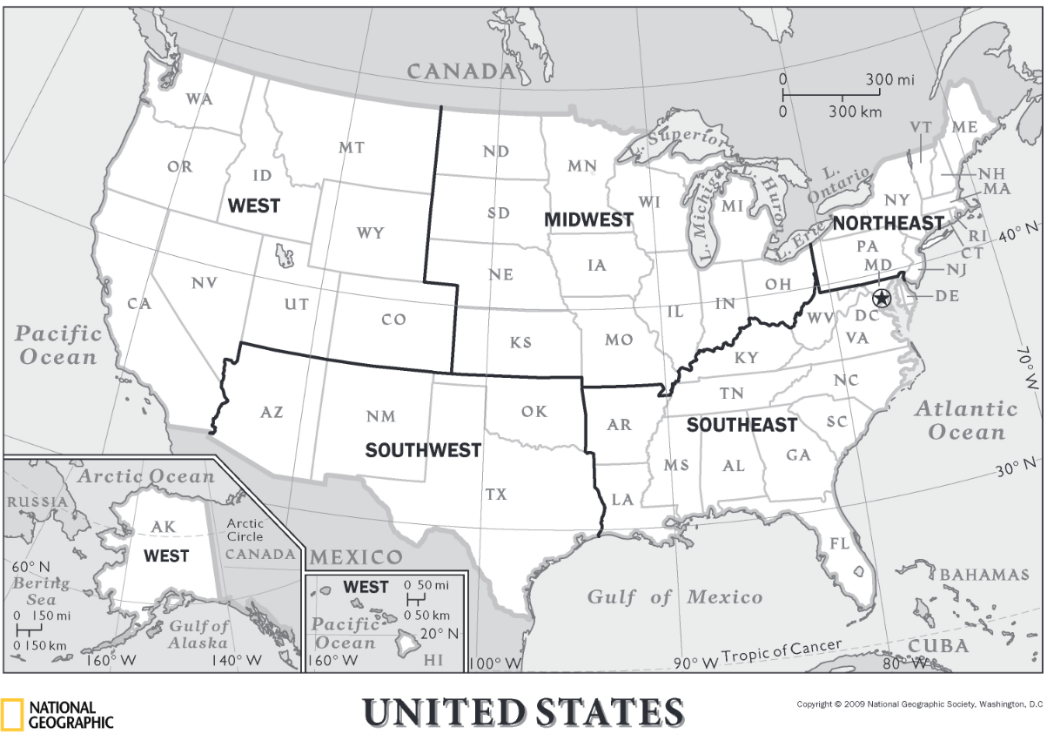
Additional Analysis
Two one-way ANOVAs were performed to see if there are differences in IBU or ABV by geographical regions of the United States
The data suggests that there are significant differences between mean IBU values between different regions (f = 3.528, p = 0.00705)
ABV mean values appear to not vary significantly between regions
Source: https://media.nationalgeographic.org/assets/file/us-regions-map.pdf

Slide 12
Additional Analysis Continued
Further analysis from IBU ANOVA post hoc tests show :
The West region has a significantly greater IBU mean values compared to the Midwest (p = 0.014)
This trend continues, but is not as strong when comparing the West to: the Northeast, Southeast, and Southwest (0.09 < p < 0.16)
The West may have a preference for beers with higher IBU values
Recommendation: Perform Market Segmentation/ Sales Research to understand consumer bitterness preferences
Source: https://media.nationalgeographic.org/assets/file/us-regions-map.pdf

Slide 13
Action point for further analysis
Normalize style to data so comparisons can be drawn between beers of the same style
This can be completed with SME’s that Budweiser has on staff
Obtain volumetric data
How much beer and of what types is a key measure in gauging the various markets

Slide 14
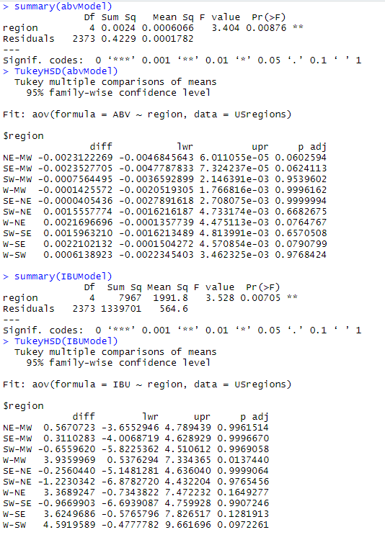
Appendix: ANOVA Output

